Slide 1
Team Zoms: Zombie Survival
By: Ryan Greene, Jack Napor, Richard Huffman,
and Danny Toback

Slide 2
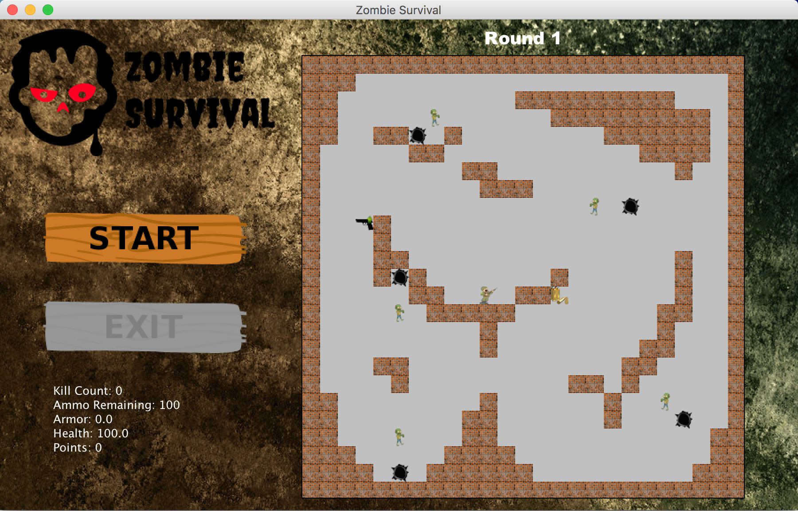
Zombie Survival
What is our game all about?
2D Birds eye view; design inspired by Call Of Duty: Zombies
Each zombie killed awards points
Points are used by the player between rounds to buy health/ammo/powerups
More zombies spawn each successive round you survive.
The overall objective is to survive as long as possible.
Impossible to win; player is playing to beat his/her high score.

Slide 3
Scrum
User Stories
Store Class
Player Class
We used Asana to keep track of all of our stories, and found that it wasn’t the best
Didn’t allow easy grouping of sprints, unless grouped together by date on the calendar (what we did)
Did allow us to organize when tasks were started, finished, and what needed to be done and by whom
We had some communication issues, where multiple people did the same class, but it ended up making the classes better coded and more efficient

Slide 4
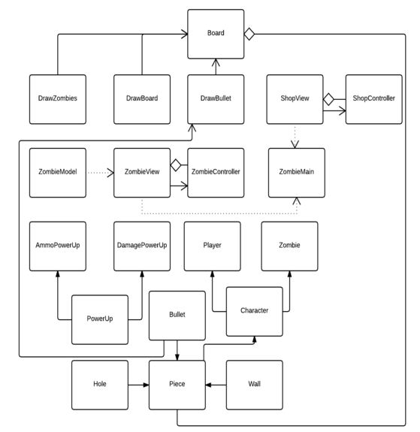
UML

Slide 5
Data Structures and Java API
The Swing Timer was used zombies moving and bullets shooting, as well as adding zombies onto the board after a period of time
A 2 dimensional array of Pieces is used as the game board
Pieces include Walls, Holes, the Player and Zombies
Board is several JComponents laid on top of eachother
Utility Timer was used for updating the rounds, and information seen on the screen
JOptionPane, ActionListener, Colors, Java Swing, etc

Slide 6
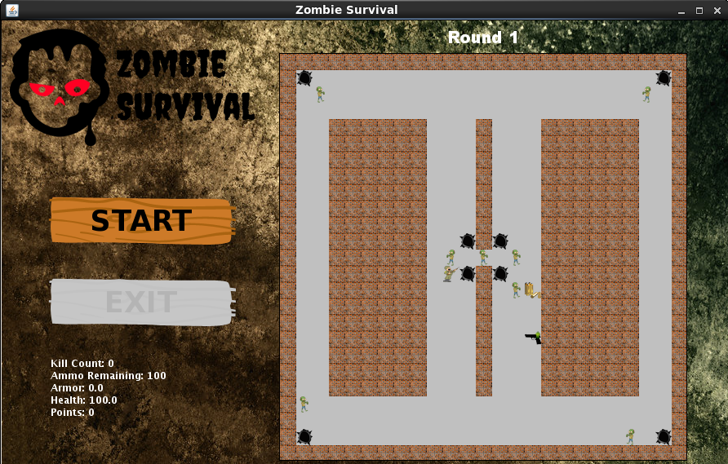
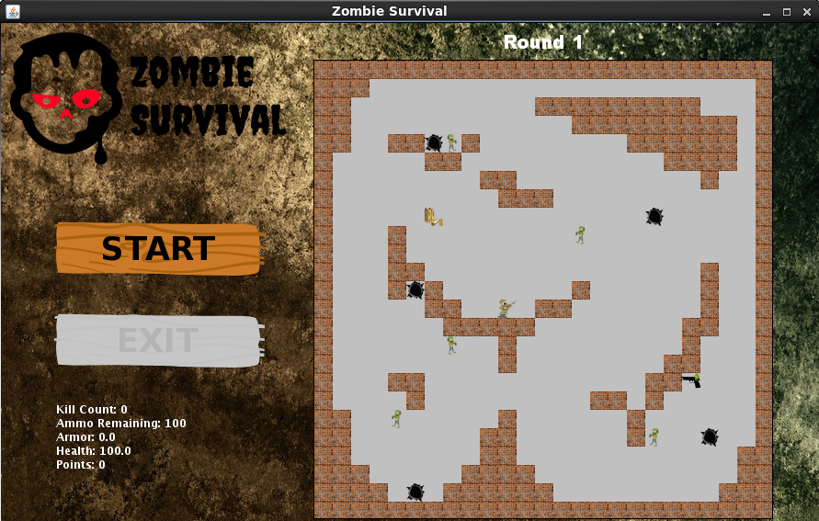
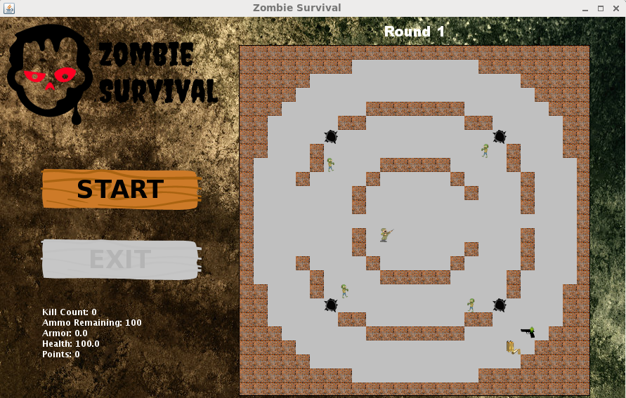
Main Menu Interface
Start/Exit buttons
The map, with Player, Zombie, Hole, Wall, and PowerUp instances on it.
A JLabel in the bottom left that keeps track of important player info (health, kill count, ammo, points)

Slide 7
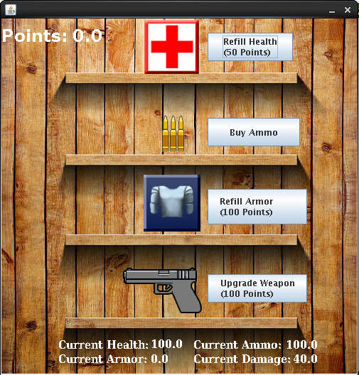
Shop Interface
Points available to be spent are displayed in upper left corner
Item icons displayed on shop shelves background
Buttons next to the items that show cost and are used to make purchases
A JLabel on the bottom displaying player info (current health, ammo, armor, damage)

Slide 8
Demo

Slide 9
Conclusion
Completely functional zombies vs. human game
Shooting, timer were especially difficult to create
We went a long time of making the “back end” of the game without having an opportunity to test our functionality
Large enough project that we don’t all understand each other’s code, or weren’t sitting in the same room for the entire production of the game

